Slide 1
WORK UPDATES PRESENTATION
FROM
Rishabh Kumar Srivastva
SAP ID- 52108159

Slide 2
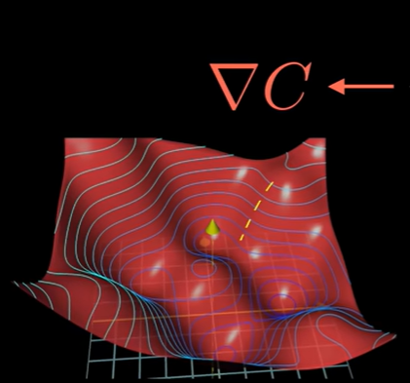
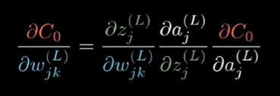
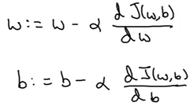
Finished work
Complete N.N. Theory
Loss and Cost Functions : like MSE, Categorical Cross Entropy.
Gradient Descent : Batch, Stochastic Gradients and Mini Batch Gradient
Backpropogation using Chain Rule
Regularization: L2 and Dropout

Slide 3
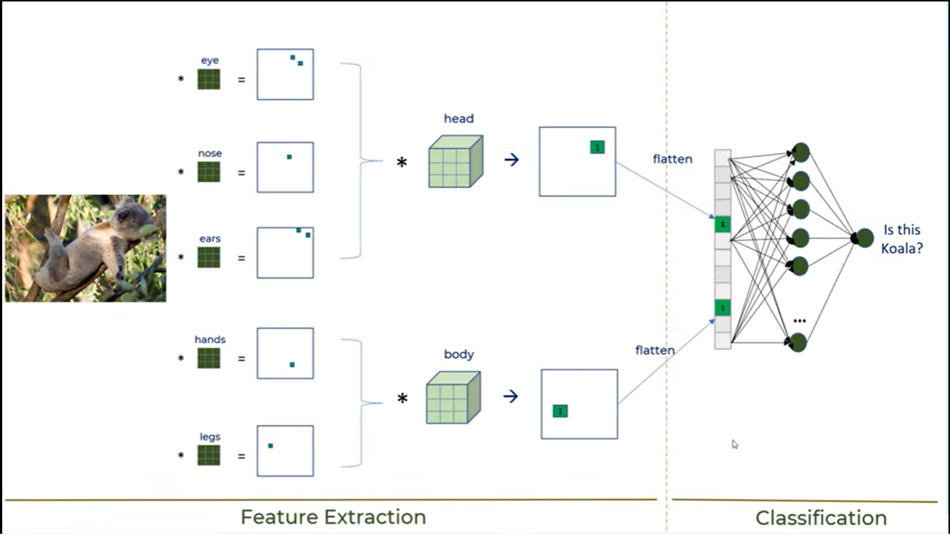
CNN Theory
Convolution theory
CNN VS DENSE Network
What are Filters
Convolution Layer, RELU, and Pooling Layer.
Implementing IMNIST data set using CNN.
Implementing IMNIST data set using only dense.
Without Dropout
With Dropout

Slide 4
FUTURE SCOPE
Implement ConvNet using PyTorch.
Learn OpenCV: Open Source Computer Vision Library

